Slide 1
UNIT 2: ORGANIZATION
1: Fundamentals of Databases and SQL
2: Filtering & String Functions
3: Aggregations & Applying Functions in SQL
4: Joins and Unions in SQL
5: Multiple Joins
6: SQL Data Aggregation
7: Subqueries in SQL
James Larkin - Data Analytics Instructor
Notes:
NOTE: Lessons with a * next to them are OPTIONAL

Slide 2
FUNDAMENTALS OF DATABASES AND SQL

Slide 3
FUNDAMENTALS OF DATABASES AND SQL
LEARNING OBJECTIVES
In today’s lesson, we will:
Review the market trend toward self-serve data access (using SQL).
Learn about database structures and the role of Structured Query Language.
Introduce SQL’s SELECT statement with WHERE clauses.
Explore practice data, using the AdventureWorks Database.
Practice a selection of query command tools, including: DISTINCT, COUNT, AND, OR,AS, and CAST.

Slide 4
FUNDAMENTALS OF DATABASES AND SQL
INTRODUCTION

Slide 5
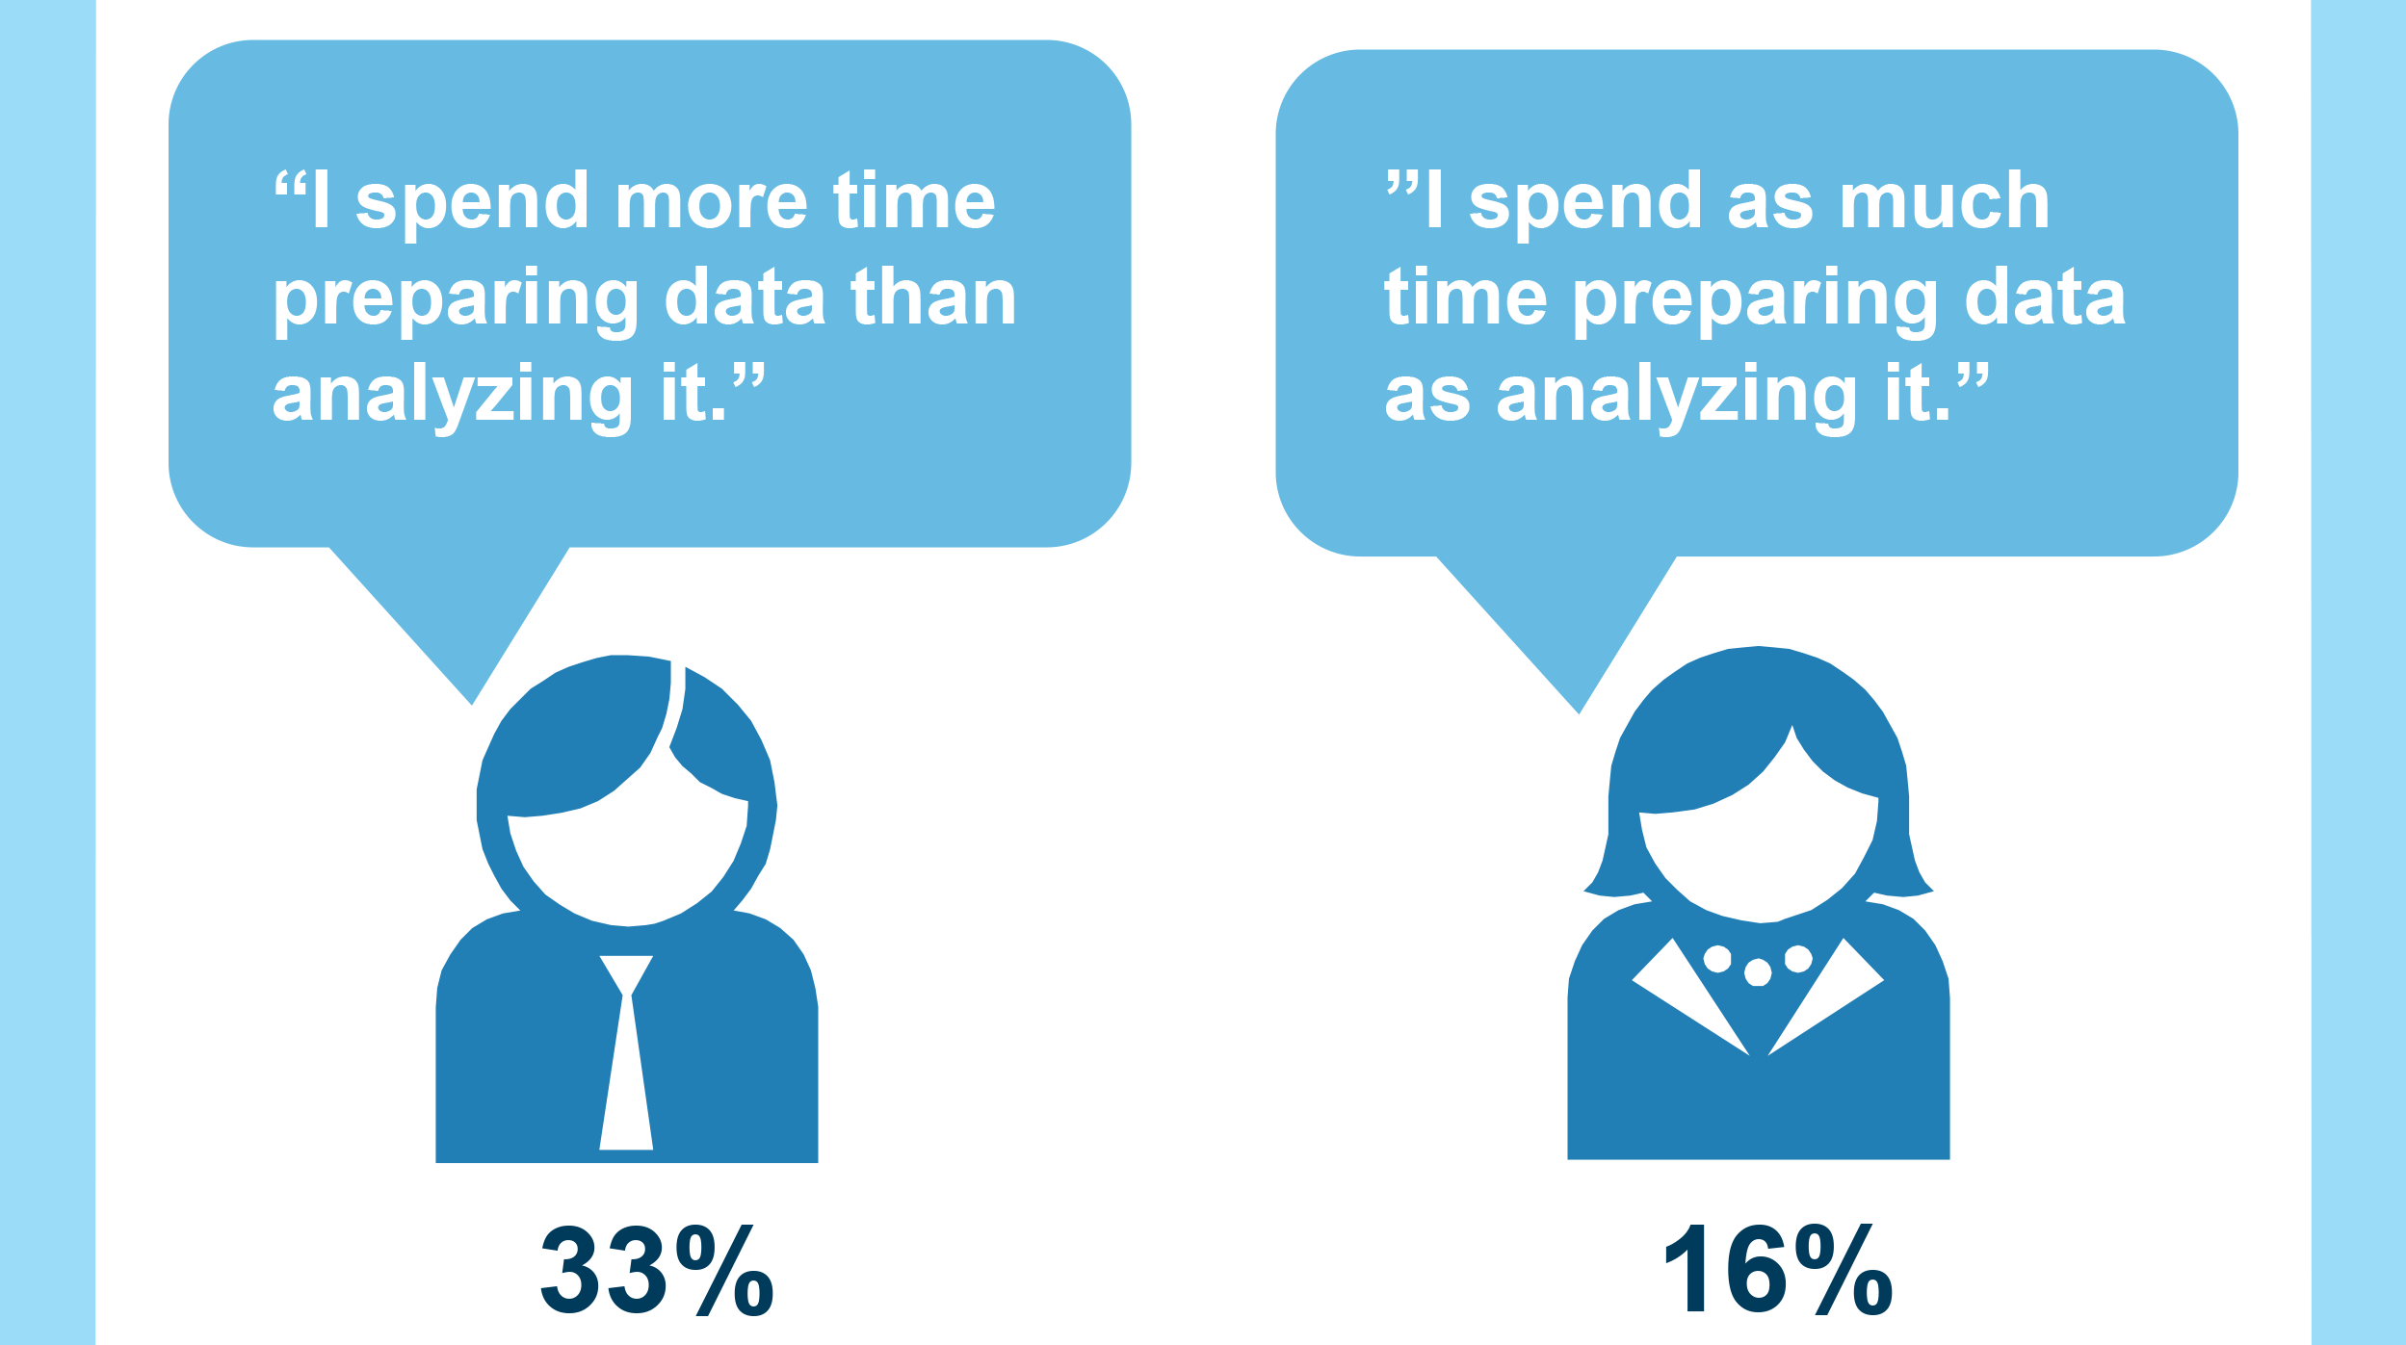
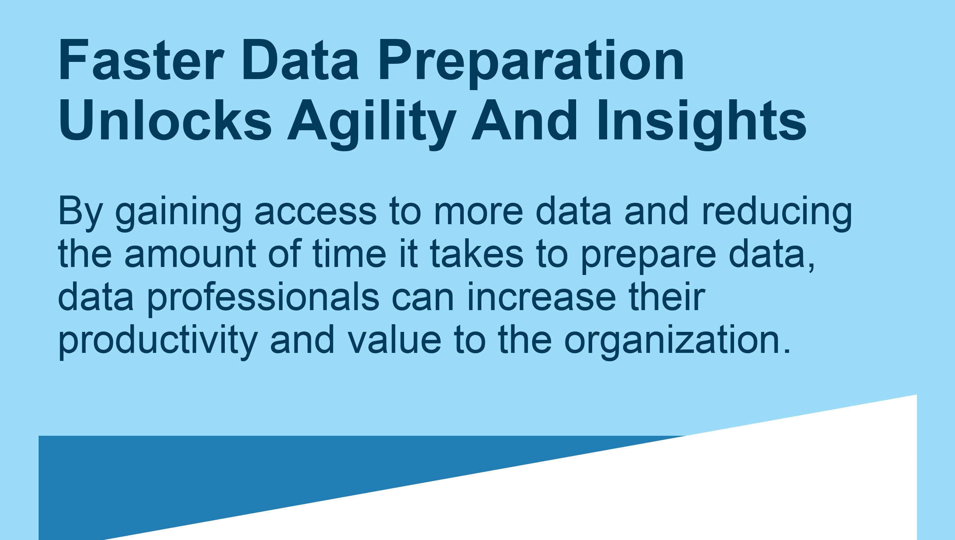
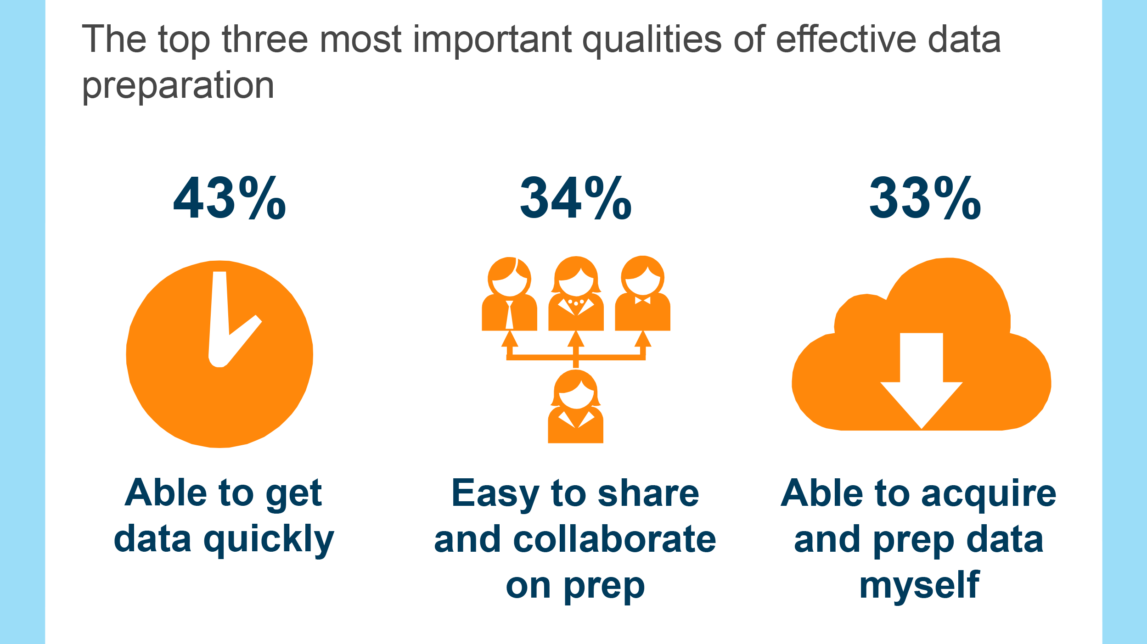
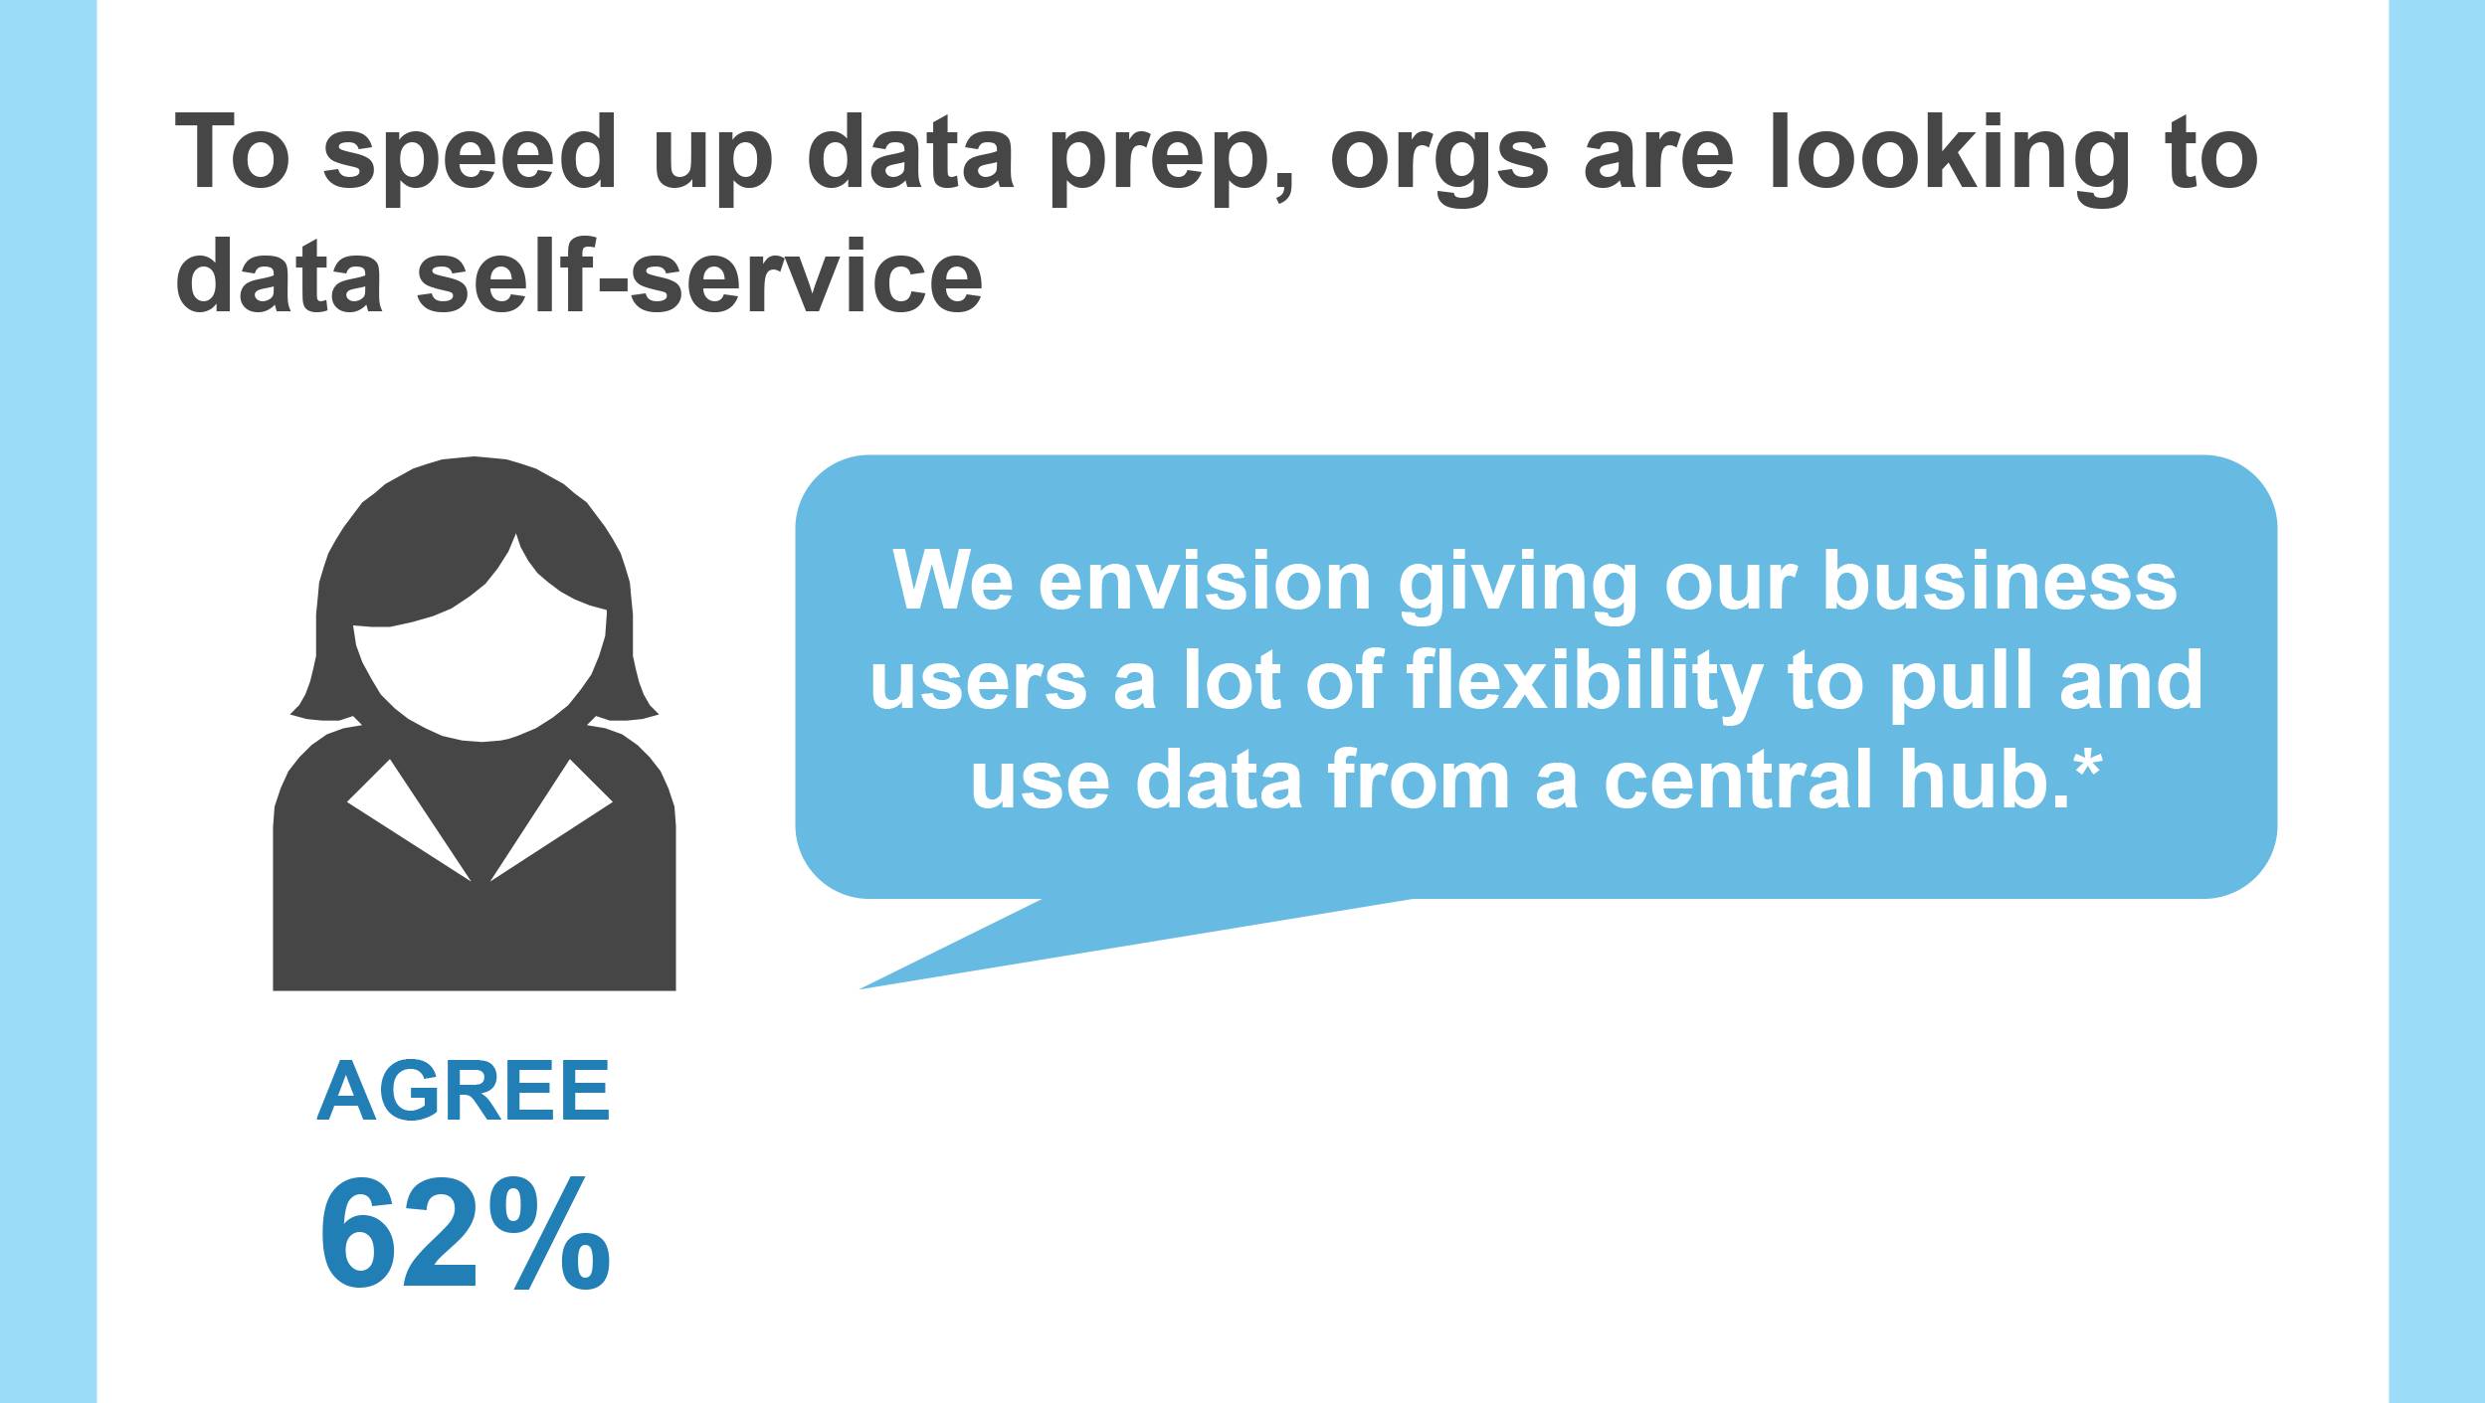
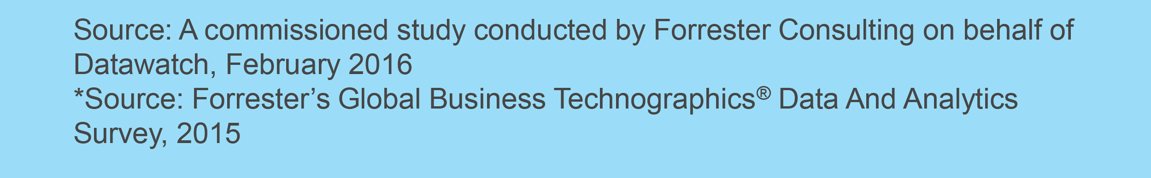

DATA ANALYTICS: AGILE WRANGLING
Analysts
Notes:
Instructor Prompt: As a reminder, this topic was brought up in Lesson 1. The idea is to provide some useful context for why we intend to discuss and teach SQL.
This example from Forrester, a reputable consulting group, lists a few reasons companies should strive to enable self-serve data access (e.g. by teaching employees how to generate their own custom SQL queries).

Slide 6
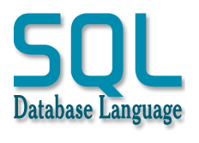
BASIC SQL
SQL (pronounced: “si-kwel”) is short for structured query language. It was developed at IBM by Donald D. Chamberlin and Raymond Boyce in the early 1970s.
There are a number of different types of SQL database implementations and platforms, all of which support standard (ANSI) SQL, including:
PostgreSQL
MySQL
MS SQL
Oracle
Notes:
Instructor Note: If students use a SQL database at work, ask them if they know which implementation it is (PostgreSQL, MySQL, MS SQL, etc.).

Slide 7
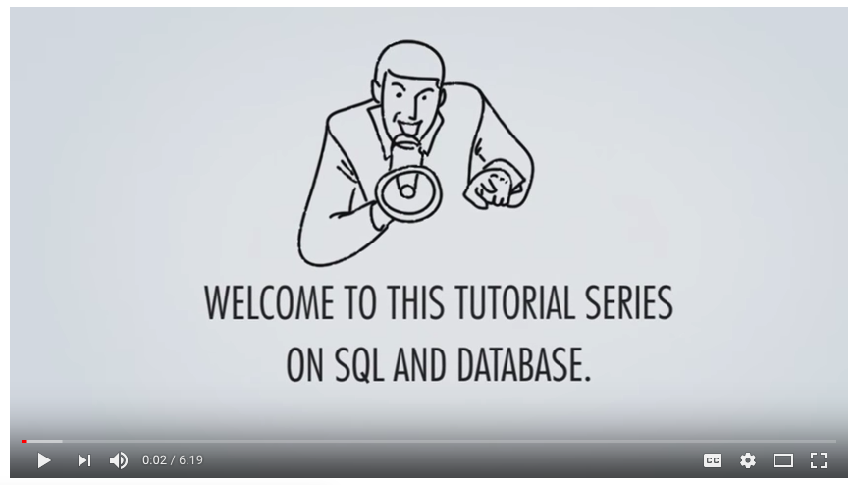
BASIC SQL
Sources: https://goo.gl/ANp296
Notes:
Instructor Note: OPTIONAL - Video linked is: https://goo.gl/ANp296. This ~6:00 min video can be used for an overview or as a brief summary. You can also share with students and request that they watch it outside of class.

Slide 8
EXCEL VS. SQL
Why do we need SQL when we have Excel?
Excel is limited by your computer’s available memory and system resources.
Excel has a fixed upper limit of 1,048,576 rows and 16,384 columns.
In other words, Excel is a local tool that is not able to capably manage or interact with very large datasets. This is when SQL steps in!
Notes:
Check: Why would you need to use SQL when you have Excel?

Slide 9
EXCEL VS. SQL
What can SQL do that Excel can’t?
SQL can rapidly navigate databases and query, retrieve, and aggregate millions of records.
SQL is also more adept than Excel at creating data flows for cleaning and preparing data at high volumes.
SQL is the industry standard for data query and retrieval.
Notes:
Check: Why would you need to use SQL when you have Excel?

Slide 10
EXCEL VS. SQL
However…
SQL is not a data visualization tool.
SQL can query and organize data, but is not typically used to analyze it.
In other words, SQL is not a complete replacement for Excel. Instead, SQL is normally used in conjunction with Excel and other tools.
Notes:
Check: Why would you need to use SQL when you have Excel?

Slide 11
EXCEL VS. SQL
Ok, so let’s summarize:
Excel and SQL use many similar functions. For example, both tools offer ways for you to apply methods like: COUNT, SUM, IF THEN ELSE, etc.
But compared to spreadsheets with tons of linked tabs, SQL databases provide users with a much more efficient way to connect related data.
SQL is also much more scalable than Excel, allowing users to remotely interact with large datasets in production environments.
Notes:
Instructor Note: Ask students about how they access their company/organization’s data. Find real-life examples from students where they mention various ways databases may already be in use in their work environments.

Slide 12
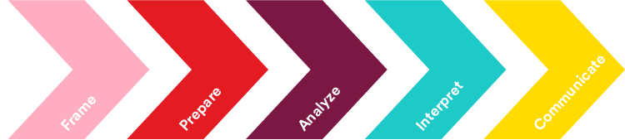
BASIC SQL: ANALYTICS WORKFLOW
Obtaining data often means accessing a SQL server to retrieve the data you need. We’ll use SQL in the second step of the GA data workflow — preparing your data: selecting, exploring, and cleaning.
Develop a hypothesis- driven approach to analysis.
Select, import, explore, & clean data.
Structure, visualize & complete analysis.
Make business decisions from data.
Present data-driven insights to audience.

Slide 13

BASIC SQL: POSTGRES
The SQL database tool we’ll use in this class is PostgreSQL. We’ll use this because:
It’s an object oriented relational database management system (DBMS).
It’s powerful and standardized.
It’s free and open source!
Note:
Many of the SQL skills we’ll learn are applicable to other SQL database implementations. Many of the same principles and syntax rules apply to other versions, like MS SQL, etc.
Notes:
Instructor Prompt: What version (or vendor) of SQL exists in your team or workplace? Instructor Note: Share an example from your own work environment specific to how databases are used, along with which relational database(s) they use and for what purpose. Some students may be familiar with Alteryx, Toad, and Oracle SQL Developer. Spend some time reviewing these applications, if applicable to the class.

Slide 14
FUNDAMENTALS OF DATABASES AND SQL
PRACTICE DATA SET: ADVENTURE WORKS DATABASE

Slide 15
BASIC SQL: SELECT STATEMENT PREVIEW
SELECT: Selects the columns.
FROM: Points to the table.
WHERE: Filters on rows.
GROUP BY: Aggregates across values of a variable.
HAVING: Filters groups.
ORDER BY: Sorts or arranges the results.
LIMIT: Limits result to the first n rows.

Slide 16
ACTIVITY: NAVIGATING THE ADVENTURE WORKS DATABASE
For this unit, we will be working as new analysts at the consulting firm Deloitte. We have been added to an account for a company named Adventure Works.
Adventure Works (AW) is a fictional company that specializes in manufacturing bicycles. The company’s product line includes 97 different brands of bikes, grouped into three categories: mountain bikes, road bikes, and touring bikes. In addition to manufacturing bicycles, AW also manufactures some of its own components. Other components are purchased from outside vendors, as well as all accessories and clothing.
Connect to the SQL database that we’ll be using for this unit.
Explore the functions of the client software (execute, stop, save, new query).
Review how the column properties are defined using the menus.
Notes:
DB table is like one sheet in excel

Slide 17



DATA DESCRIPTION: ENTITY RELATIONSHIP DIAGRAM (ERD)
sales.salesorderdetail
PK PK | salesorderid salesorderdetailid
FK1 FK2 FK3 FK4 | productid specialofferid rowguid carriertrackingnum
An ERD shows the relationships of entity sets stored in a database. An entity, in this context, is a table. This shows how tables are joined to each other.
product.transactionhistory
PK | transactionid
FK1 FK2 FK3 | productid referenceorderid referenceorderlineid
PK: Primary key
FK: Foreign key
production.product
PK | productid
FK1 FK2 FK3 | productsubcategoryid productmodelid rowguid
purchasing.purchaseorderdetail
PK, FK2 PK | purchaseorderid purchaseorderdetailid
FK1 | productid

Slide 18
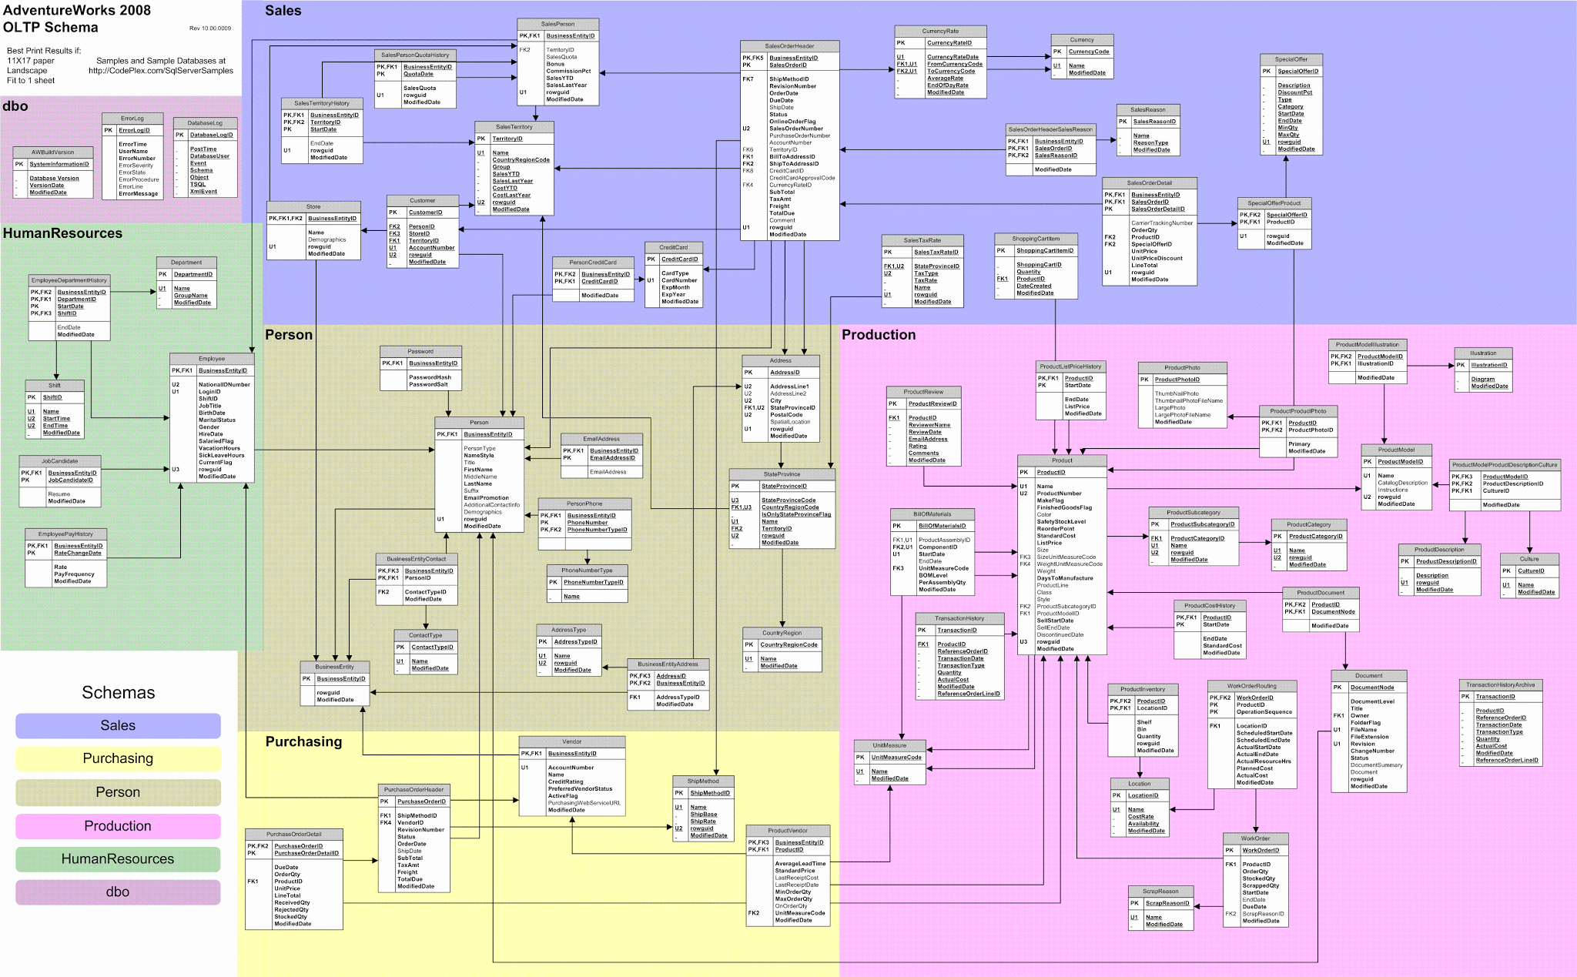
See speaker notes for more information
Notes:
Data dictionary: http://www.sqldatadictionary.com/AdventureWorks2012/database.html
Data set description: https://docs.microsoft.com/en-us/previous-versions/sql/sql-server-2008/ms124438(v=sql.100)
Diagram image link: https://i.stack.imgur.com/LMu4W.gif (note this is from 2012 and may be slightly different)
Talk about schema

Slide 19
GUIDED PRACTICE: NAVIGATION
Connect to the server by navigating to it in the object browser. We’ll explore the object browser to see how the database is organized.
Here is the directory tree we’ll need to access the data tables:
Servers (pgAdmin can be configured for more than one server configuration.)
Databases
adventureworks (our database for today)
Schemas
Production
Tables
Columns

Slide 20
GUIDED PRACTICE: NAVIGATION
If we want to view the contents of a table, we should:
Navigate to the tables of the database’s production schema.
There you should see the table “product”
To view the data, right click on the table, go to View/Edit Data, and select First 100 Rows.
Notes:
Instructor Note: 1. Show students the SQL window in pgAdmin by clicking on the TOOLS - QUERY TOOLS option (execute the command by clicking the dropdown next to the lightning bolt icon).
2. Run query SELECT * FROM products LIMIT 100; to show the results are the same as when we selected Top 100 from the context menu earlier.

Slide 21
GUIDED PRACTICE: NAVIGATION
To understand the data, we need know what the stored data means. We will refer to this as telling “the story of one row.”
Examining 100 rows of data may help us better understand if this is the data set we need to answer our research questions.
This subset allows us to preview the data.
Notes:
Check: How does “previewing” the data connect to the data workflow? Is this useful?
Instructor Note: Walk students through the new window showing a subset of the data. Point out the data types underneath the column titles.
Discuss (briefly) that part of being well-defined means that RDBMs are typed systems and that each column has a type.
Not that we will be learning about types in depth in a later class.

Slide 22
UNDERSTANDING THE ADVENTURE WORKS DATABASE
Go through the tables in the production schema and explore the data they contain.
Use the schema map to understand how tables are related to each other
Take five minutes and make notes about the database.
Write a few sentences describing the data stored in each table. Note the data types assigned to each column.
What columns could serve as links between tables later in our data exploration?
Notes:
This is a good time to talk about transactional tables and reference tables. Ask the students which table they think is the transactional table and which is ones are the reference tables. Transaction tables are tables that are updated frequently; Sales is a good example of a transactional table. The tables are very large and oftentimes updated throughout the day.
Reference or master tables are rarely modified. These are smaller tables holding information such as address or item descriptions.
When joining tables together, you always want the transactional table on the LEFT and the Reference table on the RIGHT. This will help optimize your query.

Slide 23
FUNDAMENTALS OF DATABASES AND SQL
GUIDED PRACTICE:
BASIC SQL

Slide 24
BASIC SQL
SQL is used to communicate questions to the database. The three main clauses are SELECT, FROM, and WHERE.
SELECT
Allows you to select certain columns from a table.
Determines which columns of information are downloaded.
2. FROM
Specifies the tables from which the query extracts data.
3. WHERE
Defines the relationships between the tables (JOIN conditions).
Determines which rows are selected from the tables.

Slide 25
BASIC SQL
When we selected the top 100 rows of a table using the View Data menu or Query Tool menu selections, we actually ran a SQL statement in the background:
SELECT * FROM production.product LIMIT 100;
Let’s think through these questions:
What does * mean?
What does “FROM production.product” mean?
What does the LIMIT do?

Slide 26
BASIC SQL
All queries can be run in the pgAdmin SQL window. For the remainder of the lesson, we’ll be modifying queries.
Basic Query Syntax:
SELECT column_1, column_2, column_3
FROM schema.table AS alias
LIMIT number of rows to return;
NOTE: We can use an alias to simplify the schema.table name. Use AS followed by the shortened name.

Slide 27
BASIC SQL
We can tell SELECT which columns or variables we want:
SELECT p.productid, p.name, p.productnumber
FROM production.product AS p
LIMIT 10;
We can add DISTINCT to the query statement to eliminate duplicates:
SELECT DISTINCT p.name
FROM production.product AS p;

Slide 28
BASIC SQL: FILTER WITH WHERE
We may query all columns with SELECT * or query for specific ones. Columns are presented in the order of the SELECT query line. DISTINCT further defines the results by eliminating exact duplicates. The WHERE clause filters rows by setting a criteria:
SELECT *
FROM production.product AS p WHERE p.name = 'LL Road Handlebars';
SELECT p.name, p.safetystocklevel
FROM production.product AS p WHERE p.safetystocklevel < 300;

Slide 29
BASIC SQL: ORDER BY
ORDER BY sorts results in an ascending or descending order. After the ORDER BY is a number that indicates the column by which you’re sorting.
The default sort order is ascending, but you can specify ascending (ASC) or descending (DESC) to determine the sort order.
SELECT p.name, p.standardcost
FROM production.product AS p
ORDER BY p.standardcost DESC;
Notes:
INSTRUCTOR PROMPT: Add DESC to observe the sort change in a descending fashion.

Slide 30
BASIC SQL: MANAGING NUMBERS
The ROUND function returns the given number, rounded to n places to the right of the decimal point. If n is negative, it will be rounded to n places to the left of the decimal.
Syntax: ROUND(numeric_expression, n)
Example (assume x = 177.3589):
ROUND(x, 2) would return 177.3600
ROUND(x, -2) would return 200
Notes:
KNOWLEDGE CHECK: Familiarize yourself with ROUND using the ROUND syntax
SELECT p.name, ROUND(p.standardcost, 2)
FROM production.product p
ORDER BY p.standardcost DESC;

Slide 31
BASIC SQL: DATA VALIDATION
COUNT returns the number of rows that matches some specified criteria. If the criteria includes only a column name, this returns the number of non-NULL values in that column.
Syntax: COUNT(field1)
Example:
SELECT COUNT(p.productid)
FROM production.product AS p;
More on this later….

Slide 32
BASIC SQL: AND, OR, & CAST( )
Some additional common query methods that we’ll be using include:
AND: Returns TRUE if both conditions are true.
OR: Returns FALSE if neither condition is true (TRUE if either is true).
CAST(field AS type): Converts the “field” content to the specified data type to enable comparisons.
Note: This function only works when evaluating data of the same type.
Notes:
Instructor Note: Make sure everyone is connected to the database

Slide 33
FUNDAMENTALS OF DATABASES AND SQL
INDEPENDENT PRACTICE:
BASIC SQL
Notes:
Check: What do you normally have to be aware of when doing any aggregate functions — WHERE, GROUP BY or JOINs?
Discover what this means, later… not clear.
“Will not work with hard-coded numbers — must include a query.”

Slide 34

INDEPENDENT PRACTICE: BASIC SQL
Let’s answer the following questions by writing and executing SQL queries:
How many products are there in the production.product table?
How many products have a list price greater than $500?
How many distinct products have a list price greater than $500?
What are the product IDs that have a standard cost less than $100 and a list price greater than $200?
From question 4 above, what are the names and gross profit margins (price - cost) of these items? Print the output as a money datatype. (Hint: use CAST)
How many products are black in color OR considered finished goods?
Work in small groups and share your results with the class.
EXERCISE
Notes:
INSTRUCTOR PROMPTS: See below for sample prompts and answers:
- Check: What is the difference between using AND and OR in your conditions?
How many products are there in the production.product table?
SELECT count(p.productid) FROM production.product p; (504)
How many products have a list price greater than $500?
SELECT count(p.productid)
FROM production.product p
WHERE p.listprice > 500;
(136)
How many distinct products have a list price greater than $500?
SELECT count(distinct(p.productid))
FROM production.product p
WHERE p.listprice > 500;
(136)
What are the product IDs and product names that have a standard cost less than $100 and a list price greater than $200?
SELECT p.productid
FROM production.product p
WHERE p.standardcost < 100 AND p.listprice > 200;
(816, 821)
From question 4 above, what are the names and gross profit margins (price - cost) of these items?
SELECT p.name, CAST(p.listprice - p.standardcost as MONEY) as "grossprofit"
FROM production.product p
WHERE p.standardcost < 100 AND p.listprice > 200;
"ML Mountain Front Wheel" "$116.22"
"Touring Front Wheel" "$121.21"
How many products are black or silver in color?
SELECT count(p.productid)
FROM production.product p
WHERE p.color = 'Black' OR p.finishedgoodsflag = 'true';
(299)

Slide 35
FUNDAMENTALS OF DATABASES AND SQL
CONCLUSION

Slide 36
REVIEW: FUNDAMENTALS OF DATABASES AND SQL
In today’s lesson, we learned how to :
Define database structures and the role of SQL.
Connect to our database
Define basic SQL grammar, syntax, and punctuation.
Explain how to use SQL’s SELECT statement with WHERE clauses.
Identify a range of additional SQL commands, including DISTINCT, COUNT, AND, OR, and CAST.

Slide 37
FUNDAMENTALS OF DATABASES AND SQL
Q&A

Slide 38
FUNDAMENTALS OF DATABASES AND SQL
RESOURCES

Slide 39
FUNDAMENTALS OF DATABASES AND SQL
RESOURCES
AND/OR: https://www.techonthenet.com/sql/and_or.php
CAST Function: https://msdn.microsoft.com/en-us/library/ms187928.aspx

Slide 40
FUNDAMENTALS OF DATABASES AND SQL
EXIT TICKET
DON’T FORGET TO FILL OUT YOUR EXIT TICKET!

